Slide 1
Fundamentals of Software Engineering
LECTURE 14:Class Diagram

Slide 2
Class Diagram
A Class Diagram in Software engineering is a static structure that gives an overview of a software system by displaying classes, attributes, operations, and their relationships between each other.
This Diagram includes the class name, attributes, and operation in separate designated compartments.

Slide 3
Purpose of Class Diagrams
The main purpose of class diagrams is to build a static view of an application.
It is the only diagram that is widely used for construction, and it can be mapped with object-oriented languages.
It analyses and designs a static view of an application.
It describes the major responsibilities of a system.
It is a base for component and deployment diagrams.
It incorporates forward and reverse engineering.

Slide 4
Benefits of Class Diagrams
It can represent the object model for complex systems.
It reduces the maintenance time by providing an overview of how an application is structured before coding.
It provides a general schematic of an application for better understanding.
It represents a detailed chart by highlighting the desired code, which is to be programmed.
It is helpful for the stakeholders and the developers.

Slide 5
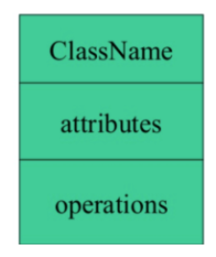
Essential elements of A UML class diagram
Essential elements of UML class diagram are:
Class Name
Attributes
Operations

Slide 6
Class Name
Following rules must be taken care of while representing a class:
A class name should always start with a capital letter.
A class name should always be in the center of the first compartment.
A class name should always be written in bold format.
UML abstract class name should be written in italics format.

Slide 7
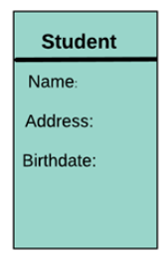
Attributes
An attribute is named property of a class which describes the object being modeled.
In the class diagram, attribute is placed just below the name-compartment.

Slide 8
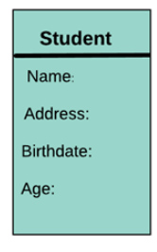
Attributes
A derived attribute is computed from other attributes. For example, an age of the student can be easily computed from his/her birth date.

Slide 9
Attributes characteristics
The attributes are generally written along with the visibility factor.
Public, private, protected and package are the four visibilities which are denoted by +, -, #, or ~ signs respectively.
Visibility describes the accessibility of an attribute of a class.
Attributes must have a meaningful name that describes the use of it in a class.

Slide 10
Member access modifiers
All classes have different access levels depending on the access modifier (visibility). Here are the access levels with their corresponding symbols:
Public (+)
Private (-)
Protected (#)
Package (~)
Derived (/)
Static (underlined)

Slide 11
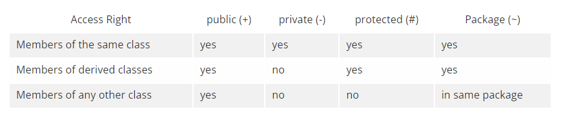
Member access modifiers

Slide 12
Operations
The lower section contain methods or operations.
The methods are represented in the form of a list, where each method is written in a single line.
It demonstrates how a class interacts with data.

Slide 13
Operations
They are services the class provides.
The return type of a method is shown after the colon at the end of the method signature.
The return type of method parameters is shown after the colon following the parameter name.

Slide 14
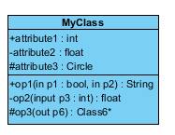
graphical representation of the class

Slide 15
graphical representation of the class
The graphical representation of the class - MyClass as shown above:
MyClass has 3 attributes and 3 operations
Parameter p3 of op2 is of type int
op2 returns a float
op3 returns a pointer (denoted by a *) to Class6

Slide 16
Relationships
There are mainly three kinds of relationships in UML:
Dependencies
Generalizations
Associations

Slide 17
Dependency
A dependency means the relation between two or more classes in which a change in one may force changes in the other.
However, it will always create a weaker relationship.
Dependency indicates that one class depends on another.

Slide 18

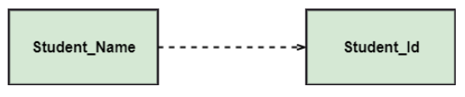
Dependency
In the following UML class diagram examples, Student has a dependency on College
In the following example, Student_Name is dependent on the Student_Id.

Slide 19
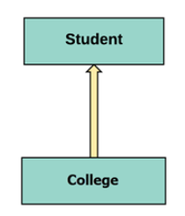
Generalization
A generalization helps to connect a subclass to its superclass.
A sub-class is inherited from its superclass. Class diagram allows inheriting from multiple superclasses.

Slide 20
Generalization
Represents an "is-a" relationship.
An abstract class name is shown in italics.
SubClass1 and SubClass2 are specializations of Super Class.
A solid line with a hollow arrowhead that point from the child to the parent class

Slide 21
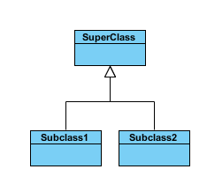
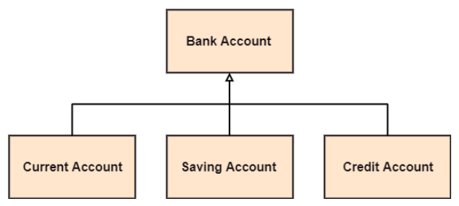
Generalization

Slide 22
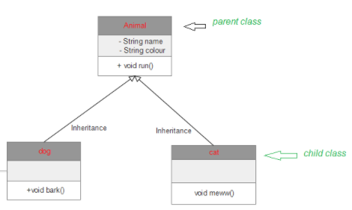
Generalization

Slide 23
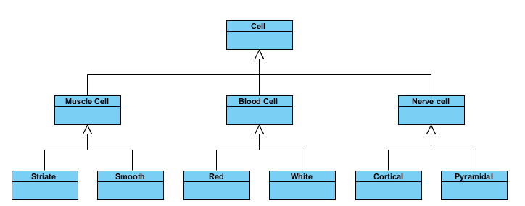
Generalization

Slide 24
Association
This kind of relationship represents static relationships between classes A and B. For example; an employee works for an organization.
Here are some rules for Association:
Association is mostly verb or a verb phrase or noun or noun phrase.
It should be named to indicate the role played by the class attached at the end of the association path.

Slide 25
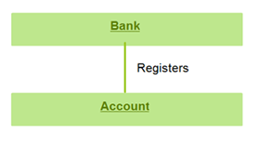
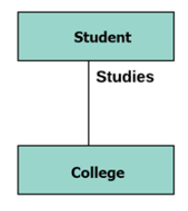
Association
In this example, the relationship between student and college is shown which is studies.

Slide 26
Multiplicity
A multiplicity is a factor associated with an attribute.
It specifies how many instances of attributes are created when a class is initialized.
If a multiplicity is not specified, by default one is considered as a default multiplicity.
Let’s say that that there are 100 students in one college.
The college can have multiple students.

Slide 27
Multiplicity
It is How many objects of each class take part in the relationships
multiplicity can be expressed as:
Exactly one - 1
Zero or one - 0..1
Many - 0..* or *
One or more - 1..*
Exact Number - e.g. 3..4 or 6
Or a complex relationship - e.g. 0..1, 3..4, 6.* would mean any number of objects other than 2 or 5

Slide 28
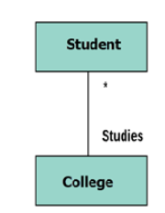
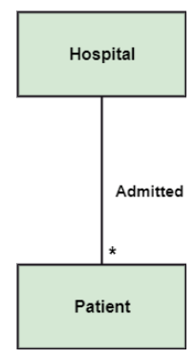
Multiplicity

Slide 29
Aggregation
An aggregation is a subset of association, which represents has a relationship.
It is more specific then association.
It defines a part-whole or part-of relationship.
In this kind of relationship, the child class can exist independently of its parent class.
The company encompasses a number of employees, and even if one employee resigns, the company still exists.

Slide 30
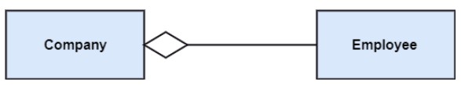
Aggregation

Slide 31

Aggregation
It represents a "part of" relationship.
Class2 is part of Class1.
Many instances (denoted by the *) of Class2 can be associated with Class1.
Objects of Class1 and Class2 have separate lifetimes.
A solid line with an unfilled diamond at the association end connected to the class of composite

Slide 32
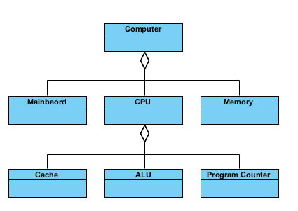
Aggregation

Slide 33

Composition
A special type of aggregation where parts are destroyed when the whole is destroyed.
Objects of Class2 live and die with Class1.
Class2 cannot stand by itself.
A solid line with a filled diamond at the association connected to the class of composite

Slide 34
Composition
The composition is a subset of aggregation.
It portrays the dependency between the parent and its child, which means if one part is deleted, then the other part also gets discarded.
It represents a whole-part relationship.
A contact book consists of multiple contacts, and if you delete the contact book, all the contacts will be lost.

Slide 35
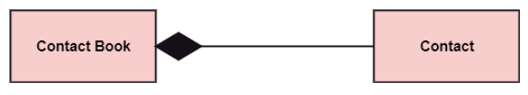
Composition

Slide 36
Aggregation vs. Composition
Aggregation | Composition
Aggregation indicates a relationship where the child can exist separately from their parent class. Example: Automobile (Parent) and Car (Child). So, If you delete the Automobile, the child Car still exist. | Composition display relationship where the child will never exist independent of the parent. Example: House (parent) and Room (child). Rooms will never separate into a House

Slide 37
Abstract Classes
In the abstract class, no objects can be a direct entity of the abstract class.
The abstract class can neither be declared nor be instantiated. It is used to find the functionalities across the classes.
The notation of the abstract class is similar to that of class; the only difference is that the name of the class is written in italics

Slide 38
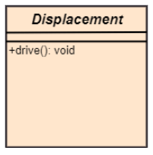
Abstract Classes
abstract class named displacement with a method declared inside it, and that method will be called as a drive (). Now, this abstract class method can be implemented by any object, for example, car, bike, scooter, cycle, etc.

Slide 39
Rules
The following points should be remembered while drawing a class diagram
The name of the class diagram should be meaningful to describe the aspect of the system.
Each element and their relationships should be identified in advance.
Responsibility (attributes and methods) of each class should be clearly identified
For each class, minimum number of properties should be specified, as unnecessary properties will make the diagram complicated.

Slide 40
Rules
Use notes whenever required to describe some aspect of the diagram.
At the end of the drawing it should be understandable to the developer/coder.

Slide 41
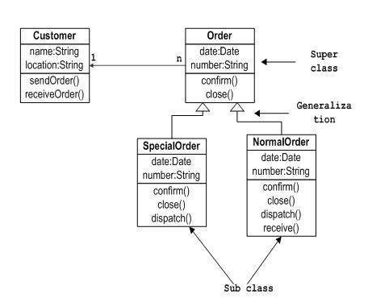

Slide 43
Explanation
First of all, Order and Customer are identified as the two elements of the system. They have a one-to-many relationship because a customer can have multiple orders.
Order class is an abstract class and it has two concrete classes (inheritance relationship) SpecialOrder and NormalOrder.
The two inherited classes have all the properties as the Order class. In addition, they have additional functions like dispatch () and receive ().

Slide 44
